Slide 1



Consuming data with F# type providers
Rachel Reese
SPONSORS

Slide 2
Consuming Data with F# Type providers
Rachel Reese | @rachelreese | rachelree.se
Jet Technology | @JetTechnology | tech.jet.com

Slide 3
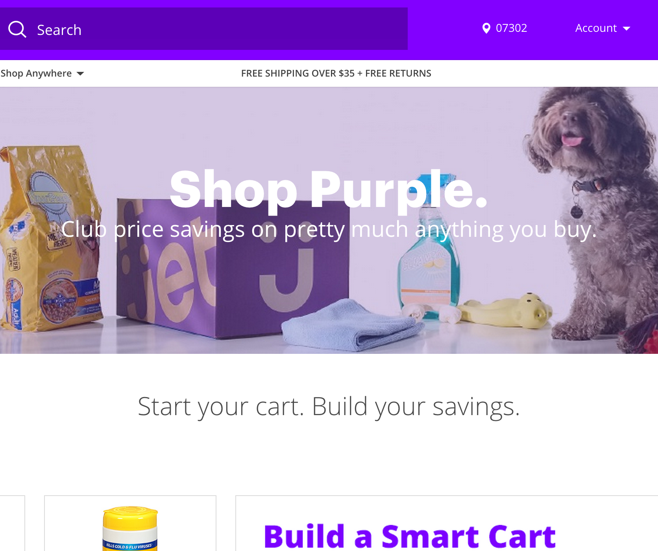

We plan to be the new Amazon.com
Launched July 22, 2015
Both Apple & Android named our app as one of their tops for 2015
Over 20k orders per day
Over 10.5 million SKUs
#4 marketplace worldwide
700 microservices
We’re hiring!
http://jet.com/about-us/working-at-jet
Notes:
400-1000 microservices.

Slide 4
Azure
Web sites
Cloud services
VMs
Service bus queues
Services bus topics
Blob storage
Table storage
Queues
Hadoop
DNS
Active directory
SQL Azure
R
F#
Paket
FSharp.Data
Chessie
Unquote
SQLProvider
Python
Deedle
FAKE
FSharp.Async
React
Node
Angular
SAS
Storm
Elastic Search
Xamarin
Microservices
Consul
Kafka
PDW
Splunk
Redis
SQL
Puppet
Jenkins
Apache Hive
Apache Tez
Notes:
Right tool for the job company. Chaos testing is the right tool.
Azure:
Storage Q for At-least-once
Svc bus for At-most-once, transactions, persistence, order guarantee
and Kafka for event distribution

Slide 5
Why F#? Expanded feature set

Slide 6

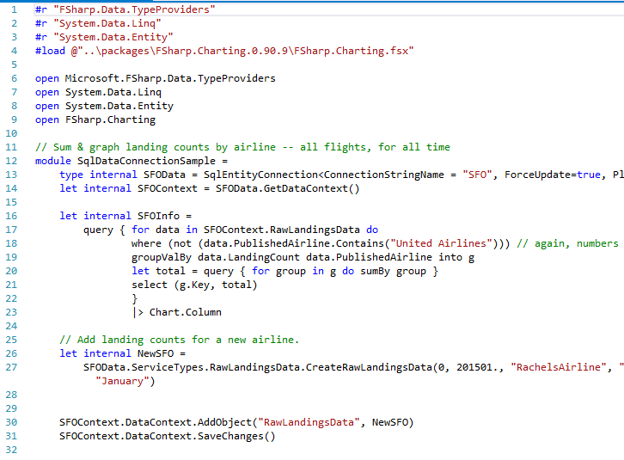
Expanded feature set: Type providers
920 pages!
31 lines!
Notes:
All the F# code is going to do is get passed a set of times / dates, perform some calculations and return an answer.
We won’t use it to do things like access a database, make web service calls to a restful API etc, these will will handle in the C# based projects.
- See more at: http://www.webigence.com/blog/f-vs-c-what-is-this-programming-key-change-all-about#sthash.X0uIT22T.dpuf

Slide 7
Using type providers

Slide 8

What are type providers?
A mechanism to provide types to the compiler
Notes:
A compiler plug in.
Get typed data into your code at design time. → Excel, csv, wsdl, xaml, sql server.
Good way to bring in other languages to F#. → Python, R, Matlab.

Slide 9

Why do we need type providers?
Because data!
Notes:
World is information-rich! Exploration is fun! Big data!
Data has a form to it, a schema. Losing that while you’re playing around is :(

Slide 10


Why do we need type providers?
Set up connection
Obtain data
Create infrastructure
Actually consume data
Because current data consumption methods!
Notes:
Missing information.
Type providers are literally 1-2 lines of set up.

Slide 11
Why do we need type providers?
More natural with REPL
No code gen!
Always in sync
Scalable to millions of types
No extra code
Intellisense, tooltips, & other tooling available
Simplicity
Elegance
Tooling
Notes:
REPL -> Discovery.
No Code Gen -> EF
EF type provider generates all the EF files, but does the generation in memory, then merges the resultant IL into your code, and cleans up after itself. No need to maintain all the EF leftover files.

Slide 12

Demos!
WSDL Mash-up
SQLDataConnection
SQLEntityConnection
Powershell
World Bank/R Mash-up

Slide 13
Some existing type providers
Powershell
Azure
Choose your own adventure
Matlab
RSS
DBML
R
MS Dynamics CRM
World Bank
CSV
JSON
XML
LINQ
XAML
WSDL
SQL Server with EF
Python
OData
Apiary
Facebook
EDMX
SignalR
Hadoop
IKVM
FunScript
Regex
Don Syme
SQLite
Squirrels
Minesweeper
MVVMCross
Rock, Paper, Scissors
Oracle
SQL Server
File System
Dates
COM
FizzBuzz
Amazon S3
Freebase
Sqlite
Azure

Slide 14
Get creative.
Get data from
Hadoop
SQL Server
RSS
CSV
OData
World Bank
JSON
Process with
Matlab
R
Powershell
Python
SignalR
R
Matlab
Visualize with
Regex
LINQ
F#

Slide 15
Writing your own type provider

Slide 16
Two questions!
How frequently will you use the type provider?
How stable is the information source’s schema?
Notes:
Just implementing an interface → like implementing a query provider for linq.
Serious bit of code. If just a one-off, don’t do it.
Stable at runtime is recommended.

Slide 17
Demo!
Developing and connecting to a homegrown type provider

Slide 18
Consuming Data with F# Type providers
Rachel Reese | @rachelreese | rachelree.se
Jet Technology | @JetTechnology | tech.jet.com

